Slide 1
Eine bessere Art Data Science zu lernen
Merlin von Trott

Slide 2
There are known knowns. These are things we know that we know. There are known unknowns. That is to say, there are things that we know we don't know. But there are also unknown unknowns. There are things we don't know we don't know.

Slide 3


Slide 4
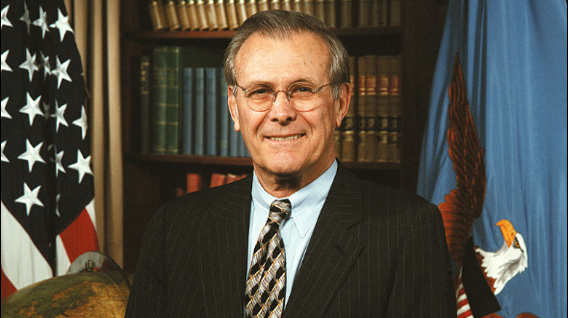

Slide 5
There are known knowns. These are things we know that we know. There are known unknowns. That is to say, there are things that we know we don't know. But there are also unknown unknowns. There are things we don't know we don't know.
Donald Rumsfeld

Slide 6
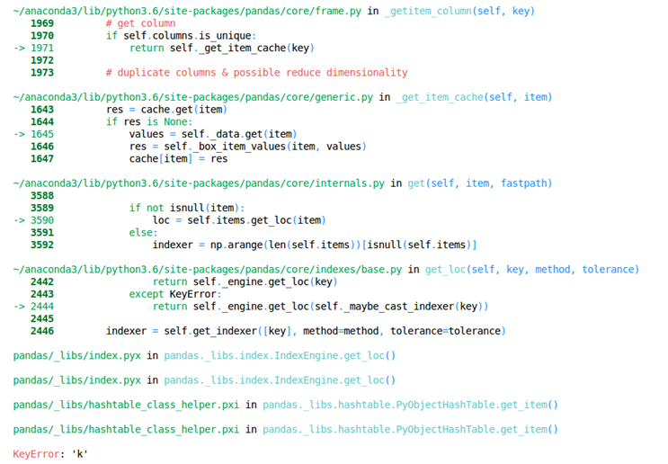

Slide 7
Genauigkeit 99,9 %

Slide 8
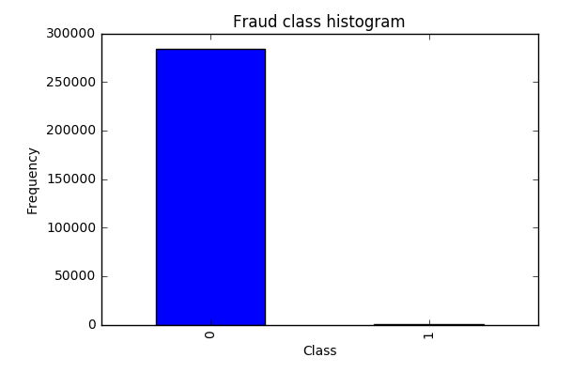

Slide 9
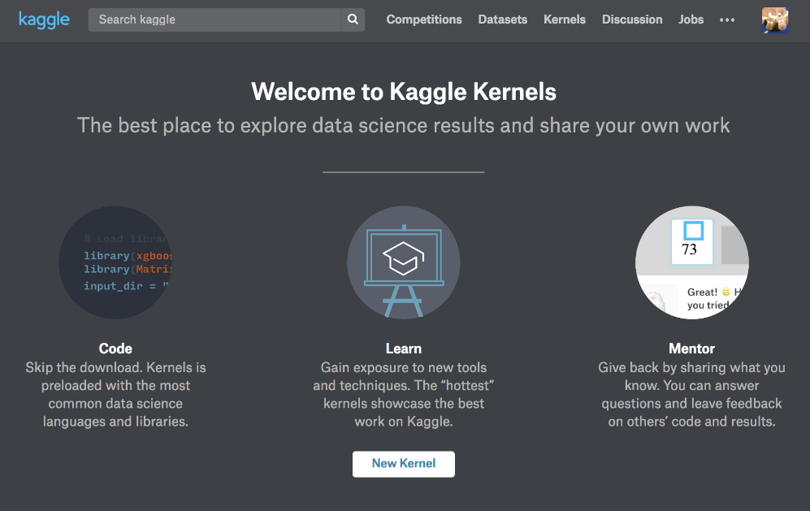

Slide 10
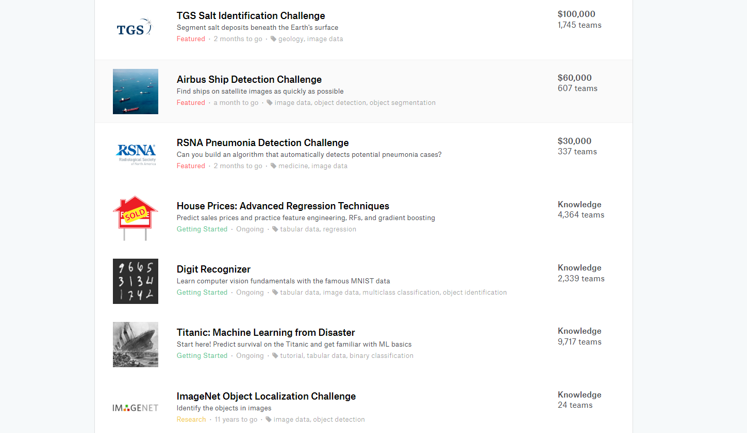

Slide 11
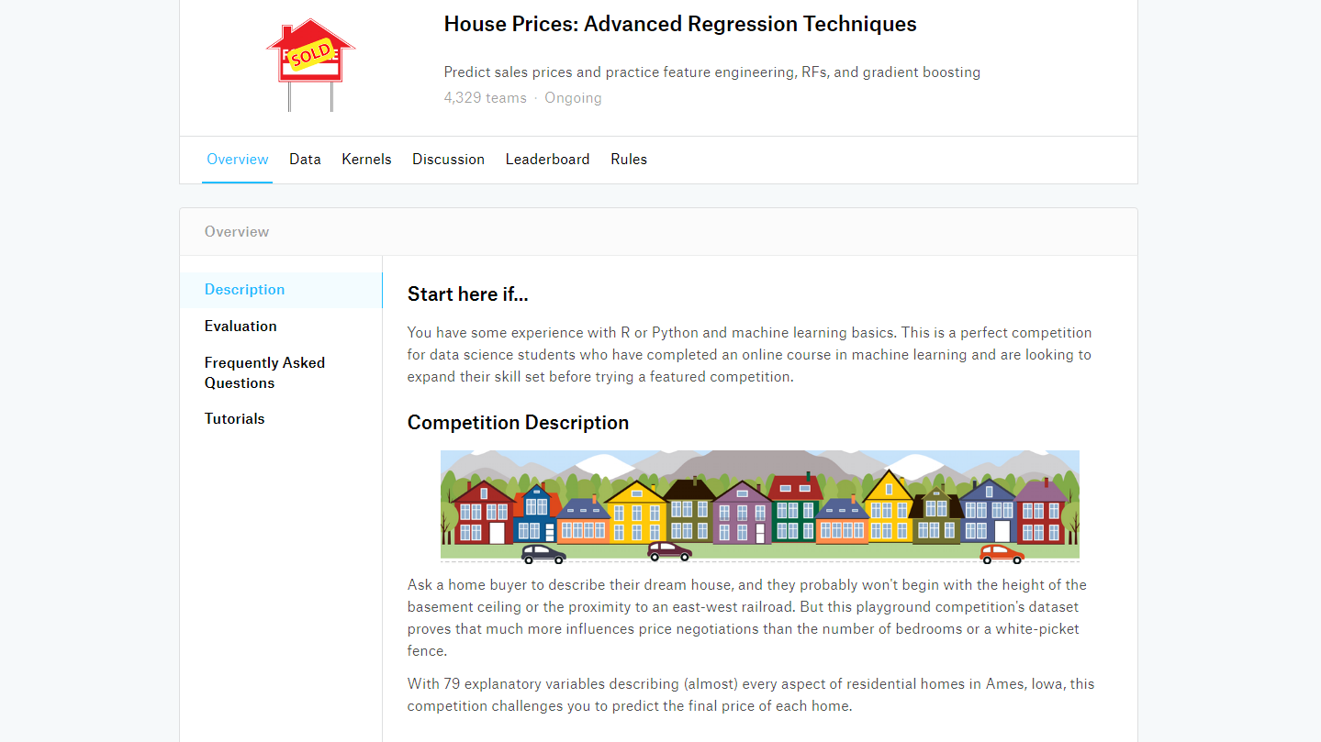

Slide 12
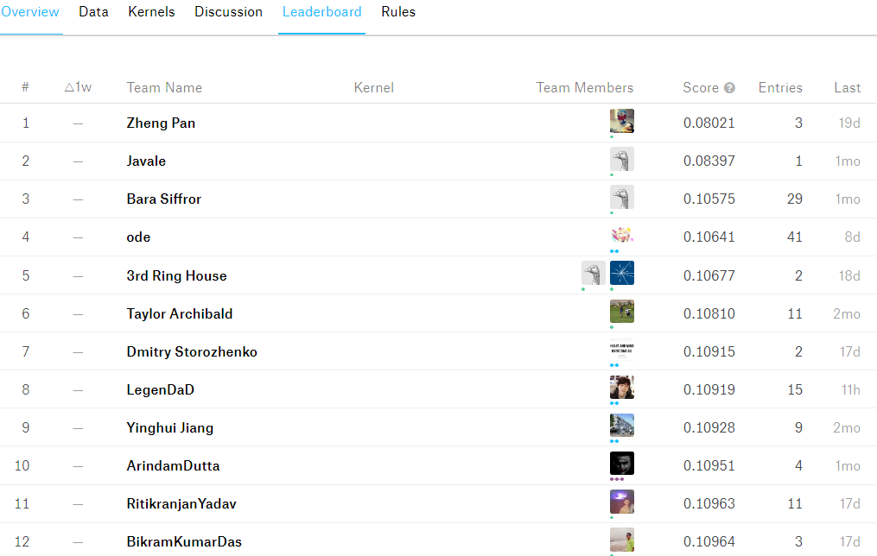

Slide 13
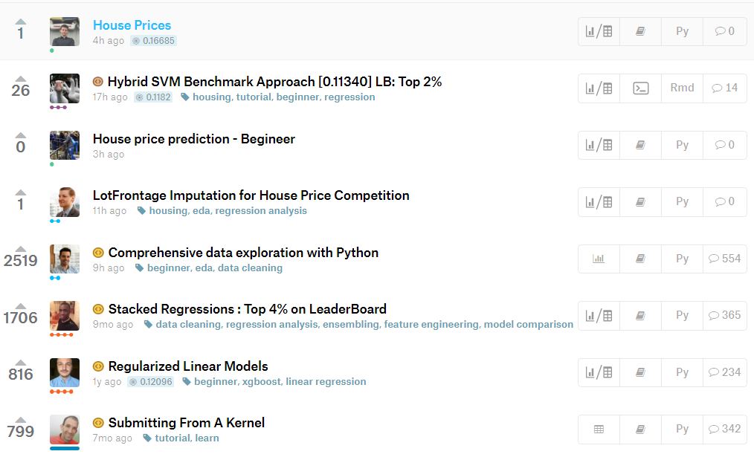

Slide 15


Slide 16
GRENZEN UND MÖGLICHKEITEN

Slide 17
Danke für eure Aufmerksamkeit
Email: Merlin.von.trott@gmail.com

